Slide 1
Stark County Governmental Law Seminar
February 28, 2026

Slide 2
OPEN MEETINGS ACT
Ohio Revised Code
Section 121.22
Presented by
John Lysenko
Assistant Prosecuting Attorney ~ Civil Division

Slide 3
“Sunlight is said to be the best of disinfectants; electric light the most efficient policeman.”
Louis D. Brandeis, 1914, Other People’s Money and How the Bankers Use It. Frederick A. Stokes Company: New York. Originally published in Harper’s Weekly. Page 92. Also http://www.law.louisville.edu/library/collections/brandeis/node/196.

Slide 4
THE PURPOSE OF THE OPEN MEETINGS ACT:
“The purpose of Ohio's OMA “is to assure accountability of elected officials by prohibiting their secret deliberations on public issues.”
State ex rel. Cincinnati Enquirer v. Hamilton Cty. Commrs., 1st Dist. Hamilton No. C-010605, 2002 WL 727023, *1 (Apr. 26, 2002)

Slide 5
PRESUMPTION OF REGULARITY
-“Under a presumption of regularity, courts should presume a public body in executive session complied with the OMA and it is the plaintiff’s burden to prove otherwise.“
State Ex Rel. Hicks v. Clermont County Bd. of Commissioners, et al. (2022), 171 Ohio St.3d 592 at ¶21.

Slide 6

https://www.ohioattorneygeneral.gov/legal/sunshine-laws
Page includes a link to the 2025 Sunshine Law Manual

Slide 7
What is a Public Body?
“Any legislative authority or board, commission, committee, council, agency, authority, or similar decision-making body . . ..” R.C. 121.22(B)(1)(a).
“Any committee or subcommittee of a body . . ..” R.C. 121.22(B)(1)(b).

Slide 8
What is a Meeting?
“Any prearranged discussion of the public business of the public body
by a majority of its members.” R.C. 121.22(B)(2).

Slide 9
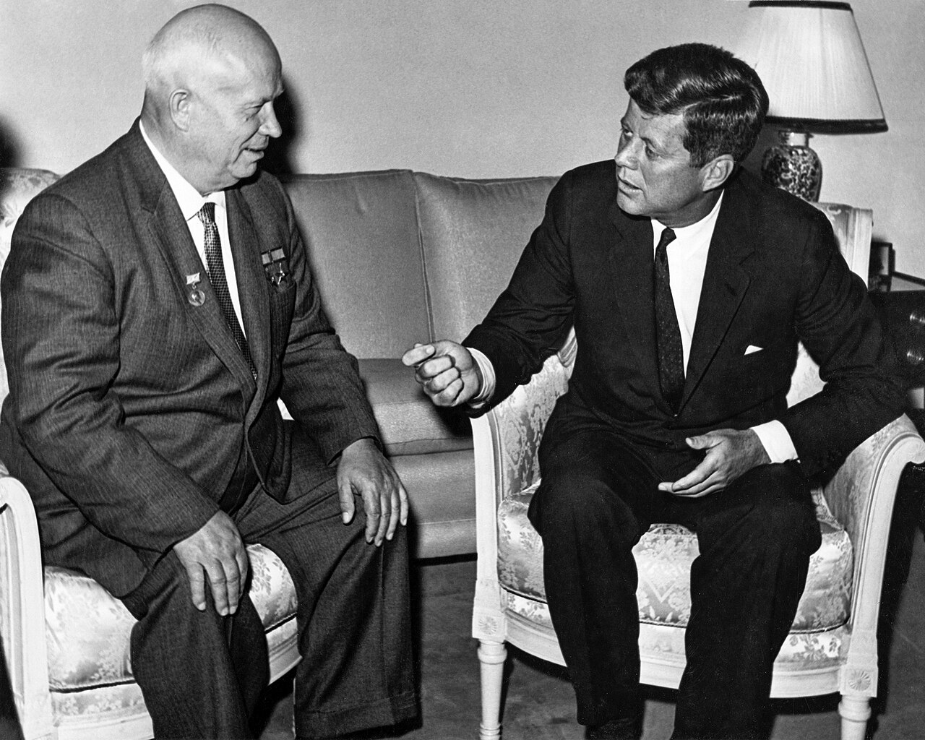

Slide 10
Liberal construction
“[R.C. 121.22] shall be liberally construed to require public officials to take official action and to conduct all deliberations upon official business only in open meetings unless the subject matter is specifically excepted by law.” R.C. 121.22(A).

Slide 11
Notice of Regular Meeting
“Every public body, by rule, shall establish a reasonable method whereby any person may determine the time and place of all regularly scheduled meetings . . . ..” R.C. 121.22(F)

Slide 12
Special Meetings
“ . . . and the time, place, and purpose of all special meetings . . .
* * *
A public body shall not hold a special meeting unless it gives at least twenty-four hours' advance notice to the news media that have requested notification, except in the event of an emergency requiring immediate official action.” R.C. 121.22(F).

Slide 13
Emergency Meetings
“In the event of an emergency, the member or members calling the meeting shall notify the news media that have requested notification immediately of the time, place, and purpose of the meeting.” R.C. 121.22(F).

Slide 14
Presumption of Public Meetings
“All meetings of any public body are declared to be public meetings open to the public at all times. A member of a public body shall be present in person at a meeting open to the public to be considered present or to vote at the meeting and for purposes of determining whether a quorum is present at the meeting.” R.C. § 121.22(C).

Slide 15
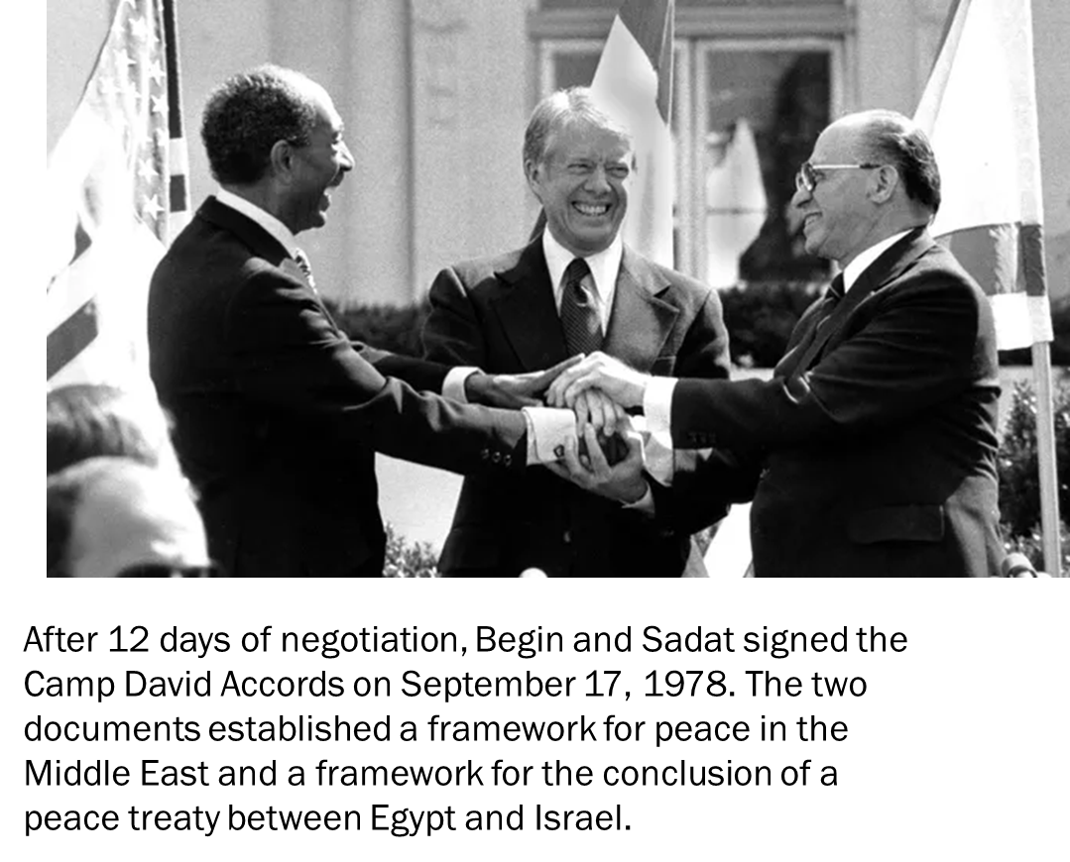

Slide 16
Discussing Public Business
“Nothing in … R.C. 121.22(B)(2) expressly mandates that a ‘meeting’ occur face to face … R.C. 121.22 prohibits any private prearranged discussion of public business by a majority of the members of a public body regardless of whether the discussion occurs face to face, telephonically, by video conference, or electronically by e-mail, text, tweet, or other form of communication.”
White v. King, 147 Ohio St.3d 74, 2016-Ohio-2770, 60 N.E.3d 1234, ¶ 15 (2016)

Slide 17
No “Round-Robin” Meetings
Unless two members constitute a majority, isolated one-on-one conversations between individual members of a public body discussing business do not violate the OMA.

Slide 18
A public body may not circumvent the requirements of the OMA by setting up back-to-back meetings of less than a majority of its members discussing the same topic of public business.
Whether by telephone, electronic, or other communications like email.

Slide 19
Open meetings (charters)
Ohio Constitution permits “home rule” – municipalities may adopt a charter governing operation.
A charter municipality has the right to determine by charter the manner in which its meeting will be held.

Slide 20
Open meetings (charters)
For charter municipalities, charter provisions for open meetings prevail over state statutes.
  State, ex rel. Craft v. Schisler, 40 Ohio St.3d 149 (1988); see also Schweikert v. Bianchi, et al., Summit Cty.C.P., Case No. CV-2021-09-2883 (a city charter may exempt certain city committees from adherence to 121.22)

Slide 21
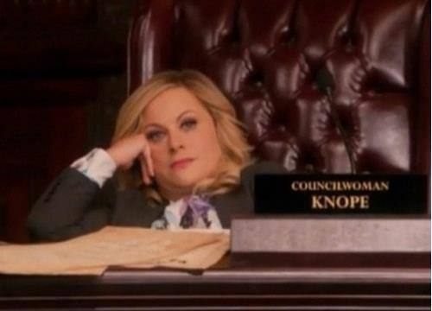

Slide 22
Public Participation
“R.C. 121.22 does not require that a public body provide the public with an opportunity to comment at its meetings . . ..”
BUT
“If the public body does, however, choose to allow public participation, such participation is subject to the protections of the First and Fourteenth Amendments to the Constitution.” [content-neutral, etc.]
Black v. Mecca Twp. Bd. of Trustees, 91 Ohio App.3d 351, 356, 632 N.E.2d 923, 926 (11th Dist.1993)

Slide 23
Public Participation
“[A] public body may not absolutely prohibit the [audio or] video recording of its meetings, though it may adopt reasonable regulations.”
McVey v. Carthage Twp. Trustees, 4th Dist. Athens No. 04CA44, 2005-Ohio-2869, ¶ 3

Slide 24
Exceptions
Some public bodies may meet in private
  Grand Jury;
  Some licensing boards; and
  Some professional disciplinary boards.

Slide 25
Executive Sessions
Executive Session is a very formal process.

Slide 26
Executive session
“[T]he members of a public body may hold an executive session only after a majority of a quorum of the public body determines, by a roll call vote, to hold an executive session and only at a regular or special meeting . . ..” R.C. 121.22(G)

Slide 27
Executive session
“If the executive session is to be held to consider one of the enumerated exceptions, then ‘the motion and vote to hold that executive session shall state which one or more’ of those matters listed in the exceptions will be discussed . . The executive session then may be held ‘for the sole purpose of the consideration of’ one of the listed exceptions.”
Myers v. Hensley, 3rd Dist. Hardin No. 6-99-02, 1999-Ohio-877.

Slide 28
The Eight (8) Reasons (R.C. 121.22(G)
Personnel matters
Purchase of property (when confidential)
Consult attorney about litigation
Collective bargaining
Confidential by some specific law
Security matters
(Hospital matters)
Confidential information related to marketing plans, etc.
That’s it! And, these are to be strictly construed.

Slide 29
Executive Session - Personnel
For personnel:
“[T]he motion and vote to hold that executive session shall state which one or more of the approved purposes listed in division (G)(1) of this section are the purposes for which the executive session is to be held, but need not include the name of any person to be considered at the meeting.”

Slide 30
Executive Session - Personnel
For personnel you must state:
appointment,
employment,
dismissal,
discipline,
promotion,
demotion, or
compensation of a public employee or official, and
the investigation of charges or complaints against a public employee, official, licensee, or regulated individual . . ..”
R.C. 121.22(G)(1).

Slide 31
Executive Session - Personnel
“Except as otherwise provided by law, no public body shall hold an executive session for the discipline of an elected official for conduct related to the performance of the elected official's official duties or for the elected official's removal from office.”
R.C. 121.22(G)(1).

Slide 32
Executive Session - Personnel
“By using general terms like ‘personnel’ and ‘personnel and finances' instead of one or more of the specified statutory purposes, respondents violated R.C. 121.22(G)(1).”
Maddox v. Greene Cty. Children Servs. Bd. of Dirs., 2nd Dist. No. 2013-CA-38, 2014-Ohio-2312, 12 N.E.3d 476, ¶ 18

Slide 33
Executive Session - Personnel
“County children services board's vote … was invalid … even though board took formal action against director by firing her in an open meeting, and executive session preceding vote to fire director was held for permissible purpose under Act, where bulk of deliberation and decision-making regarding director's discharge occurred in prior executive sessions that violated the Act.”
Maddox v. Greene Cty. Children Servs. Bd. of Dirs., 2nd Dist. No. 2013-CA-38, 2014-Ohio-2312, 12 N.E.3d 476

Slide 34
Not Executive Session
Quasi-judicial deliberations:
  Applies only to bodies exercising quasi-judicial functions in an administrative tribunal (such as zoning appeals).
  After open public discussion and evidence, a body may retire to “deliberate” on its decision.
  Any subsequent vote must be in open meeting.
  If in doubt, it is probably not quasi-judicial.

Slide 35
Violations of OMA
A resolution, rule, or formal action of any kind is invalid unless adopted in an open meeting of the public body.
Any person may bring an action to enforce this section.

Slide 36
Violations of OMA
Injunction by court to compel the members of the public body to comply with its provisions.
Civil forfeiture of five hundred dollars to the party that sought the injunction.
Court costs and attorney fees (but attorney fees not recoverable by pro-se parties).
Removal from office (for violation of injunction).

Slide 37
Minutes
Minutes shall be promptly prepared, filed, and maintained and shall be open to public inspection.
  Enough information to permit the public to understand and appreciate the rationale behind the public body’s decision.
  Executive session minutes need only reflect the general subject matter of executive session.

Slide 38
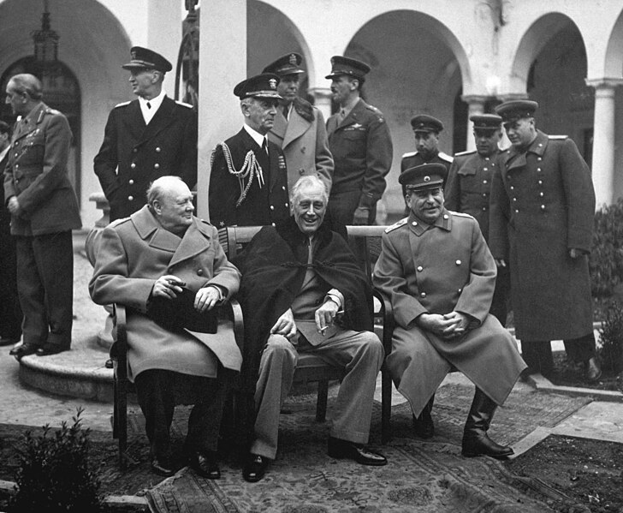
YALTA CONFERENCE FEBRUARY 4-11, 1945
A famous WWII meeting.

Slide 39
Where to hold Meetings
A public body must conduct business in a venue that is open to the public.
A meeting venue must have space to accommodate all interested members of the public – and must be ADA compliant

Slide 40
CASE HIGHLIGHTS and UPDATES

Slide 41
State Ex Rel. Hicks v. Clermont County Bd. of Commissioners, et al. (2022), 171 Ohio St.3d 592 at ¶18.
-“the laundry list case”
-Overruled the Hardin case so far as it imposed a “burden of production” upon a public body.
-“Under a presumption of regularity, courts should presume a public body in executive session complied with the OMA and it is the plaintiff’s burden to prove otherwise.“ Id. at ¶21.
-“Hicks argues that the burden of production must be placed on the public body because the public body is the only party who might have evidence of what occurred in any executive session. This argument is flawed for two reasons. First, the plaintiff will have access to the same evidence as the public body through discovery. And if a public body follows the requirements of R.C. 121.22, it may not have any evidence of what occurred in executive session beyond what is recorded in the meeting minutes. Second, the difficulty involved in proving a violation of the OMA is a policy choice for the General Assembly. If the General Assembly had been concerned about access to evidence in these types of cases, it could have written R.C. 121.22 to place the burden of production on the public body. But it chose not to.”

Slide 42
Ames v. Brimfield Township Board of Trustees, 2019-Ohio-4926, 149 N.E.3d 933 (11th Dist. Portage Cty.)
2019 case. The 11th District Court of Appeals held that the minutes must reflect particular reason for entering into executive session. At least one of the exceptions identified in 121.22(G)(1) must be identified in the minutes.
Board of Trustees had entered the executive session but only stated “R.C. 121.22(G)(1)” as the reason in the minutes.

Slide 43
Ames v. Rootstown Twp. Board of Trustees, 172 Ohio St.3d 1, 2022-Ohio-4605, 221 N.E.3d 793
1) when repeated conduct results in multiple violations of a single provision of the OMA, trial court may issue a single injunction;
2) when single injunction is issued to address multiple violations of the OMA through same conduct, trial court is required to order the public body to pay a single civil forfeiture of $500 as to all offenses; and
3) trial court complied with OMA when it addressed board's alleged OMA violations through single injunction and related civil forfeiture.

Slide 44
State Ex Rel. Ames v. Portage County Board of Commissioners, et al., 165 Ohio St.3d 292, 2021-Ohio-2374, 178 N.E.3d 492
The use of a “consent agenda” may constructively close the public meeting because it failed to inform the public which resolutions were being voted upon at the particular meeting.

Slide 45
State of Ohio Ex Rel. Ames v. Portage County Board of Commissioners, et al., 11th Dist. Portage Cty., No. 2017-P-0093, 2018-Ohio-2888, 2018 WL 3536749 at ¶22-23.
“In order for the OMA to apply, the public body must ‘deliberate’ over public business at a meeting.”
“Deliberation” has been characterized as something more than “information gathering” by a public body.

Slide 46
State ex rel. Ames v. Portage County Board of Commissioners, 2024-Ohio-1852 (11th Dist.) ¶57
10th District Court of Appeals upheld trial court’s determination:
“[w]hen the public body’s motion to enter executive session is based upon an approved purpose and an unapproved one, the motion is based upon an unapproved purpose.”

Slide 47
Look Ahead America, et al. v. Stark Cty. Bd. of Elections, et al., 11th Dist. Stark Cty., No. 22-CA-00152
-pending on appeal in Ohio Supreme Court, 2023-1059
Sole Proposition of Law considered:
“Proposition of Law No. 1
Under R.C. 121.22(G)(2), members of a public body may meet in an executive session to consider “the purchase of property for a public purpose” but, then, only to consider information the premature disclosure of which would give an unfair competitive or bargaining advantage to a person whose personal, private interest is adverse to the general public interest.”

Slide 48
Look Ahead America, et al. v. Stark County Board of Elections
(2) To consider the purchase of property for public purposes, the sale of property at competitive bidding, or the sale or other disposition of unneeded, obsolete, or unfit-for-use property in accordance with section 505.10 of the Revised Code, if premature disclosure of information would give an unfair competitive or bargaining advantage to a person whose personal, private interest is adverse to the general public interest. No member of a public body shall use division (G)(2) of this section as a subterfuge for providing covert information to prospective buyers or sellers. A purchase or sale of public property is void if the seller or buyer of the public property has received covert information from a member of a public body that has not been disclosed to the general public in sufficient time for other prospective buyers and sellers to prepare and submit offers.
Ohio Supreme Court decided that in an executive session entered to consider the purchase of property for public purposes, the purchase being considered must also be subject to the condition underlined above.
Look Ahead America. et al. v. Stark County Board of Elections, et al., 2024-Ohio-2691, ¶19.

Slide 49
Barga v. St. Paris Village Council, 2024-Ohio-5293
Ohio Supreme Court finds that when a public hearing is required by R.C. 121.22(G)(1) a public body cannot enter an executive session to further consider the same matter considering dismissal of a public employee. Case was remanded “to allow the village council to consider the issue in compliance with the Open Meetings Act.”

Slide 50
Kyle E. Smith v. Village of Cleves, Ohio, et al., 1st Dist. Ct. of Appeals Case No. C 2600016
Case challenging content of minutes and stated reasons for entering executive session currently pending in the 1st District Court of Appeals.

Slide 51
CONSENT AGENDAS
Ames v. Columbus City School Dist. Bd. of Edn., 2024-Ohio-3411 (10th Dist.), appeal not allowed by 177 Ohio St.3d 1414, 250 N.E.3d 130 (Table), 2025-Ohio-231.
The Ohio Supreme Court declines to review case challenging use of consent agendas where the 10th District Court of Appeals found that the use of consent agendas was not contrary to the OMA.

Slide 52
HB 609
This item is pending in the Ohio legislature and would, among other things, require:
An allowance for a public commentary and testimony; and
In the event of emergency meeting, require members calling the meeting to immediately notify the news media that have requested notice where the current law exempts emergency meetings.

Slide 53
H.B. 257, effective 4-9-2-25
Authorizes members of certain public bodies to hold and attend meetings and conduct and attend hearings virtually, by video conference or other similar electronic technology, when certain conditions are met.

Slide 54
QUESTIONS & COMMENTS
John Lysenko
jlysenko@starkcountyohio.gov
330.451.7636

